Slide 1
Research of early childhood regulation difficulties in Hungary “For Healthy Offspring” project
Noemi Scheuring et al.
Budapest, Hungary

Slide 2
Authors
Noemi Scheuring¹, Ildiko Danis², Judit Gervai³, Tunde Nemeth⁴, Antal Czinner¹, Laszlo Szabo¹
¹Heim Pál Children’s Hospital, Budapest, Hungary,
²Semmelweis University, Budapest, Hungary
Bright Future Human Research and Consulting Ltd., Göd, Hungary,
³Institute of Cognitive Neuroscience and Psychology, Hungarian Academy of Sciences
⁴National Institute of Child Health, Budapest, Hungary

Slide 3
Heim Pál Children's Hospital
in Budapest
… is one of the
largest
pediatric
hospitals
in Europe.
http://www.heimpalkorhaz.hu/

Slide 4
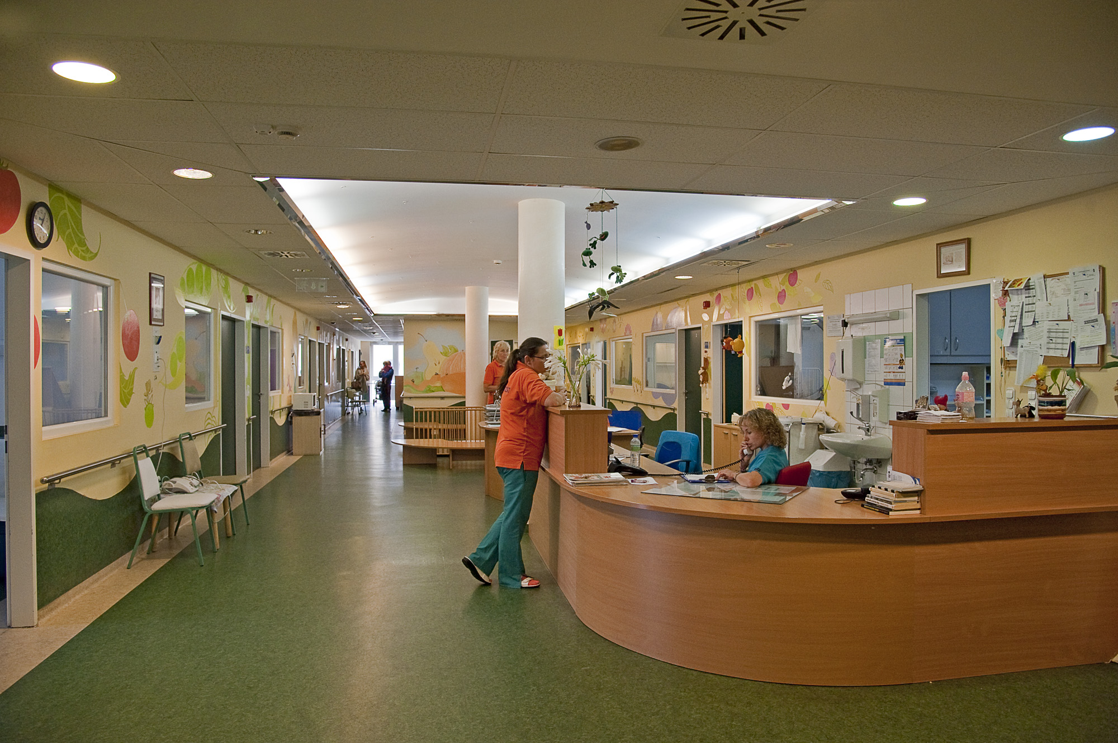
280 doctors work in our hospital.
We operate with 500 beds and also provide outpatient services.
Thus, we manage almost 37,000 inpatients and 500,000 outpatients per year.
Furthermore we are a teaching hospital.

Slide 5
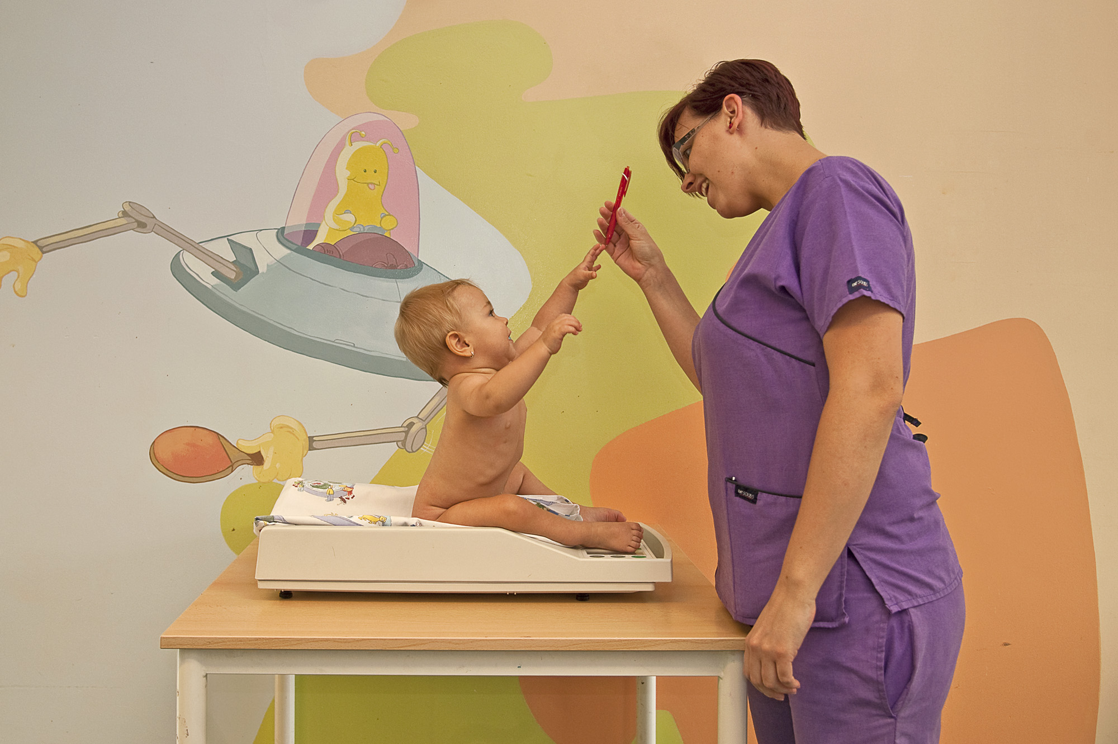
Besides the classical medical work,
mental health support of children
and their families is also in focus.
Our scientific work has been extended to this field too.

Slide 6
Program ’FOR HEALTHY OFFSPRING’
Heim Pál Children’s Hospital provided subjects for the project called ’FOR HEALTHY OFFSPRING’
which was the first Hungarian research project examining
the prevalence of behaviour regulation problems in early childhood and
the significance of different underlying risk and protective factors.

Slide 7
Program ’FOR HEALTHY OFFSPRING’
Families of 0–3-year-old children (n=1165) were included in the study from Heim Pál Children’s Hospital and the local regions.
Data were collected using
questionnaires,
diagnostic assessments and
consultations.
The questionnaires were filled out by the parents of the participating children
only mothers: n = 811
only fathers: n = 31
both parents: n = 322

Slide 8
Program ’FOR HEALTHY OFFSPRING’
The questionnaires included detailed questions about
the parents’ socioeconomic status,
the medical and psychological description of pregnancy and delivery,
the child’s medical status and behaviour, and
the classical regulation problems (crying, feeding, sleeping).
The set of questionnaires edited by our team (Scheuring, Danis and Gervai)
were considered as providing basic information.

Slide 9
Program ’FOR HEALTHY OFFSPRING’
The first section deals with
family background,
social and work circumstances,
financial status,
parents’ health status,
physical and psychological description of pregnancy and delivery,
the postnatal period of children,
breastfeeding,
early care,
children’s physical illnesses, psychological symptoms and behaviour.

Slide 10
Alcohol consumption
Did you drink alcohol during pregnancy?
Do you drink alcohol?
Subject | (n) | (%)
YES | 12 | 1,0%
NO | 1120 | 96,1%
Missing | 33 | 2,8%
Total | 1165 | 100,0%
Subject | (n) | (%)
YES | 66 | 5,7%
NO | 1059 | 90,9%
Missing | 40 | 3,4%
Total | 1165 | 100,0%
(n = 1165)
YES: 12 (1,0%)
YES: 66 (5,7%)

Slide 11
Smoking
Do you smoke generally?
Did you smoke during pregnancy?
Subject | (n) | (%)
YES | 232 | 19,9%
NO | 894 | 76,7%
Missing | 39 | 3,3%
Total | 1165 | 100,0%
Subject | (n) | (%)
YES | 118 | 10,1%
NO | 1008 | 86,5%
Missing | 39 | 3,3%
Total | 1165 | 100,0%
(n = 1165)
YES: 232 (19,9%)
YES: 118 (10,1%)

Slide 12
Did you have an uneventful pregnancy?
(n = 1165)
Subject | (n) | (%)
YES | 762 | 65,4%
NO | 366 | 31,4%
Missing | 37 | 3,2%
Total | 1165 | 100,0%
NO: 366 (31,4%)

Slide 13
Was there any risk of premature birth?
(n = 1165)
Subject | (n) | (%)
YES | 130 | 11,2%
NO | 291 | 25,0%
Missing | 744 | 63,9%
Total | 1165 | 100,0%
YES: 130 (11,2%)

Slide 14
Was the pregnancy planned?
(n = 1165)
YES: 855 (73,4%)
Subject | (n) | (%)
YES | 855 | 73,4%
NO | 256 | 22,0%
Missing | 54 | 4,6%
Total | 1165 | 100,0%
NO: 256 (22,0%)

Slide 15
Was your delivery difficult?
(n = 1165)
Subject | (n) | (%)
YES | 331 | 28,4%
NO | 780 | 67,0%
Missing | 54 | 4,6%
Total | 1165 | 100,0%
YES: 331 (28,4%)

Slide 16
What was your delivery experience like?
Subject | (n) | (%)
5 | 314 | 27,0%
4 | 324 | 27,8%
3 | 269 | 23,1%
2 | 132 | 11,3%
1 | 76 | 6,5%
Missing | 30 | 4,3%
Total | 1165 | 100,0%
Missing
1
2
3
4
5
1.+2.= 208 (17,8%)
Bad
Good
(n = 1165)

Slide 17
Do/did you have breastfeeding difficulties?
(n = 1165)
Subject | (n) | (%)
YES | 575 | 49,4%
NO | 494 | 42,4%
Missing | 96 | 8,2%
Total | 1165 | 100,0%
YES: 575 (49,4%)

Slide 18
My child is sucking impatiently/eagerly
(n = 1165)
Subject | (n) | (%)
YES | 77 | 6,6%
NO | 549 | 47,1%
Missing | 539 | 46,3%
Total | 1165 | 100,0%
YES: 77 (6,6%)

Slide 19
My child choked and gagged.
(n = 1165)
Subject | (n) | (%)
YES | 26 | 2,2%
NO | 600 | 51,5%
Missing | 539 | 46,3%
Total | 1165 | 100,0%
YES: 26 (2,2%)

Slide 20
Do/did you have support in early care?
(n = 1165)
Subject | (n) | (%)
YES | 934 | 80,2%
NO | 194 | 16,7%
Missing | 37 | 3,2%
Total | 1165 | 100,0%
NO: 194 (16,7%)

Slide 21
Have you ever visited a child psychologist?
(n = 1165)
Subject | (n) | (%)
YES | 34 | 2,9%
NO | 1045 | 89,7%
Missing | 86 | 7,4%
Total | 1165 | 100,0%
YES: 145 (12,4%)

Slide 22
Program ’FOR HEALTHY OFFSPRING’
For the second section we used questionnaires that have already been adapted in Hungary:
parents’ mood, depressive symptoms (DS1K; Halmai et al.)
mother’s perception of the child (H-MORS-SF; Oates and Gervai)
child temperament (IBQ-R and ECBQ; Rothbart and Garstein, Hungarian adaptation: Lakatos, Gervai and Tóth)
life events in the family (Life events; Tóth and Danis)

Slide 23
Questionnaires
Further scale:
H-MORS-SF* → MORS Hungarian short-form (H-MORS-SF;
Scales of the 14-item H-MORS-SF assess parents' perceptions of their infants: 'warmth-coldness' and 'invasion-withdrawal‘.
Mothers’ Object Relations Scales (MORS)
instrument assessing parents’ internal representation of their child’s relationship with them.
Developed by Oates, validated in British and Hungarian moderate-sized samples
(Oates, 1998; Oates & Gervai, 2003; Oates et al., 2006).

Slide 24
Questionnaires
Babies’ and infant’s behavioural assessments are based on the parental questionnaires.
Infant Behavior Questionnaire-Revised IBQ-R (0-18 months)
Early Childhood Behavior Questionnaire, ECBQ (from 18 months)
Babies’s and Children’s temperament assessment with shortened form questionnaires. Scales: surgency, negative affectivity, effortful self-control. (18-36 months)

Slide 25
Oates, Gervai, Danis, Tsaroucha 2005
Oates, Gervai, Danis, Lakatos, Davies, 2006
Milford, Oates, 2009
Davies, Slade, Wright, Stewart, 2008

Slide 26
Mother-infants dyads based on correlation patterns
No. | Scales | Possible extension | Clusters |  |  |  |  | Centroid differences
 |  |  | Cl.1 | Cl.2 | Cl.3 | Cl.4 | Cl.5 | df | F | P< | Post Hoc Tesztek
 |  |  | (n=81) | (n=207) | (n=267) | (n=104) | (n=169)
1 | Invasion H-MORS-SF | 0-35 | 16,10 | 6,85 | 6,08 | 7,59 | 13,11 | 4,82 | 380,51 | 0,001 | Cl1>Cl5>Cl4,Cl2>Cl3
2 | Warmth H-MORS-SF | 0-35 | 25,16 | 30,75 | 31,61 | 22,94 | 30,97 | 4,82 | 245,99 | 0,001 | Cl5,Cl3,Cl2>Cl1>Cl4
3 | Surgency IBQ-R ,ECBQ vsf | 1-7 | 5,04 | 5,05 | 5,19 | 4,54 | 5,39 | 4,82 | 17,10 | 0,001 | C1,Cl2,Cl3,Cl5>Cl4
4 | Negative affectivity IBQ-R ,ECBQ vsf | 1-7 | 3,93 | 3,41 | 3,04 | 3,54 | 3,58 | 4,82 | 16,34 | 0,001 | Cl1,Cl2,Cl4,Cl5>Cl3
5 | Effortful controll IBQ-R ,ECBQ vsf | 1-7 | 4,58 | 5,48 | 5,66 | 5,06 | 5,15 | 4,82 | 43,73 | 0,001 | Cl2,Cl3 >Cl4,Cl5>Cl1
6 | The parents’ Parents’ depressive symptoms DS1K | 0-27 | 16,23 | 14,29 | 7,68 | 10,30 | 11,75 | 4,82 | 261,25 | 0,001 | Cl1>Cl2>Cl5>Cl4>Cl3

Slide 27
Outstanding group
The Cl.1 cluster:
The highest rate of parental depression was found here, which correlated with the parental perception of the child’s invasiveness, negative affection and low level of self-control.
The children’s positive affection and surgency were at medium level in this cluster compared to the other groups.
Only 10% of parents belonged here, maybe they can be considered as a risk group for the child’s temperament, perception and state of their mind.

Slide 28
Conclusion
Approaching the child’s pathological symptoms and/or the parent’s complaints from a bio-psycho-social aspect seems to be an effective method in recognising, evaluating and treating them effectively.
Early recognition would be promoted by psychological screening.

Slide 29
Questions?

